Slide 1
Anomaly Detection in Wind Turbine SCADA Data
King’s Graduate School, Monroe University
CS633: Data Mining
Professor: Nicholas Nardi
Presented by: Leslie Hadaway, Chang Liu

Slide 2
Table of Contents
Introduction
Original Project Overview
Updates and Improvements
Data Analysis and Modeling
Challenges and Lessons Learned
Conclusion
Q&A

Slide 3
Introduction
Purpose:
Developing an anomaly detection system for wind turbines
Proactive maintenance of potential equipment failures to optimize maintenance
Business Impact:
Enhance operational efficiency and reduce maintenance costs
Improve reliability and lifespan of wind turbine
Notes:
Purpose: This project aims to transition from a generic energy output prediction to a robust anomaly detection system focusing on advancing maintenance strategies through predictive insights.
Business Impact: Implementing this system is expected to significantly cut down operational downtimes and maintenance expenditures by enhancing predictive maintenance operations. This will directly contribute to increased profitability and risk mitigation by preventing unexpected turbine failures.
Agenda: We will start with an overview of the original project, followed by discussing the updates made to integrate anomaly detection capabilities. Key project methodologies and data mining techniques will be covered.

Slide 4
Original Project Overview

Slide 5
Original Project Overview
Objective: Develop machine learning models to predict wind turbine failures.
Dataset: Utilized “ReneWind” dataset, compromising operational data, including sensor data and maintenance records
Model Development: Implemented and compared various machine learning algorithms
Model Evaluation: Assessed models to determine the most effective approach
Notes:
The original project aimed to develop machine learning models capable of predicting wind turbine failures. To achieve this, the ‘ReneWind’ dataset was employed, containing comprehensive operational data from wind turbines, such as sensor readings and maintenance logs
For model development, various machine learning algorithms were implemented and compared. Each model was evaluated using metrics such as accuracy, precision, recall, and F1-score to identify the most effective approach for predicting turbine failures.

Slide 6
Updates and Improvements

Slide 7
Updated Project Proposal
Objectives: Develop a proactive anomaly detection system for wind turbines
Anticipated Outcome: Reduced downtime, enhanced maintenance strategies, lower costs
Key Improvements:
Shifting from energy output prediction to anomaly detection
Switched to unsupervised machine learning using Isolation Forest to detect anomalous turbine behavior - a practical solution given the lack of failure labels in the dataset
Notes:
In this project, we pivot from merely predicting energy outputs to developing an anomaly detection system. Our objectives include reducing operational downtime and improving predictive maintenance strategies. Key improvements over the original setup involve utilizing

Slide 8
Data Mining Scope
Goals:
Clean and process sensor data
Model development for anomaly detection
Success Criteria:
Visual validation through anomaly overlays on time series plots
Score distribution separation
Statistical comparison between anomalies and normal behavior
Notes:
Our data-mining goals revolve around cleaning and pre-processing sensor data, followed by developing robust models.

Slide 9
Data Collection and Description
Dataset Selection:
Used SCADA dataset from Aventa AV-7 Wind Turbine
Sourced from Zenodo, covering January 2022 to July 2023
Collection Methodology:
Downloaded via Python from Zenodo
Metadata files were included to provide context for SCADA measurements
Includes operational and environmental turbine parameters sampled at 1-second intervals
Data Structure:
Size: Approximately 39.7 million records, 11 columns
Key Features: Datetime, Rotor Speed, Generator Temperature, Wind Speed, Power Output and more
Notes:
To set the stage for our data mining project, understanding the dataset is crucial. We use the SCADA dataset from the Aventa AV-7 wind turbine, available on Zenodo. It provides comprehensive 1Hz time-series data from January 2022 to July 2023.
The dataset contains nearly 40 million rows across 11 columns, with key features like Rotor Speed, Generator Speed, Generator Temperature, Wind Speed, and Power Output.
Metadata accompanies the dataset, detailing SCADA channels for measurement reliability and turbine specifications. This ensures a holistic view, supporting our objectives of anomaly detection and performance assessment.
The dataset’s scale, structure, and quality provide a strong foundation for our project’s next phases.

Slide 10
Data Analysis and Modeling
Notes:
Welcome to the data analysis and modeling section of our presentation. Here, we delve into key facets of the dataset used in our project.

Slide 11
Exploring Data
Dataset Overview:
Total Rows: ~39.7 million
Total Columns: 11
Data Quality:
Missing Values: Minimal impact with a total of 5 missing entries across all fields
Duplicate Rows: None detected
Descriptive Statistics:
Key metrics indicate a wide spread across several attributes, with potential outliers
Notes:
Our dataset consisted of approximately 39.7 million rows and included a total of 11 attributes.
Regarding data quality, the dataset was found to have negligible missing values and no duplicate entries, maintaining the integrity of our analyses.
Descriptive statistics indicated a wide spread in data values, which alerted us to the presence of outliers and potentially unrealistic values that could skew our analyses.

Slide 12
Verifying Data Quality
Outliers and Unrealistic Values:
Extreme values observed in Generator Temperature (-95.1℃ to 107.3℃) due to sensor errors
Unrealistic Power Output (negative values not possible)
Maximum Wind Speed anomalies (up to 187, 458 m/s)
Handling Missing and Unrealistic Values:
Missing values were imputed using linear interpolation
Outliers were capped based on realistic physical constraints:
Generator temperature corrected to -30℃ to 100℃
Wind speed up to 60 m/s
Power Output set to non-negative
Resampling and Interpolation:
Dataset resample to 1-second intervals to fill in gaps
Missing time points interpolated
Notes:
We identified significant anomalies, such as extreme temperature readings likely caused by sensor malfunctions and implausibly high wind speeds. Negative power output readings, which are physically impossible, were also noted.
To address these issues, we implemented linear interpolation to estimate missing values and capped extreme outlier values within realistic constraints for attributes like temperature, wind speed, and power output.
We further refined the data by resampling it at one-second intervals, ensuring consistent time series data for accurate modeling.
These data preparation steps were foundational in ensuring that our subsequent modeling efforts were based on reliable, high-quality data.

Slide 13
Univariate and Bivariate Analysis
Distribution Analysis (Univariate):
Box Plots: Identified data spread in key features like Rotor Speed, Generator Temperature, and Wind Speed, highlighting variability and extreme values
Histograms: Revealed data distributions, skewness and concentration, informing potential feature transformations
Correlation Heatmap (Bivariate):
Exposed key relationships, such as strong correlations between Power Output, Rotor Speed, Generator Temperature, Wind Speed, and Pitch Degree, highlighting feature importance and potential multicollinearity
Feature Selection:
Chose Rotor Speed, Generator Temperature, Wind Speed, Power Output, Max Wind Heute, and Pitch Degree based on variability and correlation, with the focus on detecting operational anomalies
Notes:
We analyzed feature importance to refine our model.
Box plots assessed spread and detected outliers in key features like Rotor Speed and Generator Temperature, revealing central tendencies and variability.
Histograms highlighted data distribution, skewness, and concentrations, guiding necessary transformations.
A correlation heatmap uncovered key relationships such as the strong link between Power Output, Wind Speed and Rotor Speed, identifying influential features while also revealing potential multicollinearity.
Ultimately, we selected Rotor Speed, Generator Temperature, Wind Speed, Power Output, Max Wind Heute, and Pitch Degree based on variability and correlations while addressing multicollinearity to ensure model stability.

Slide 14
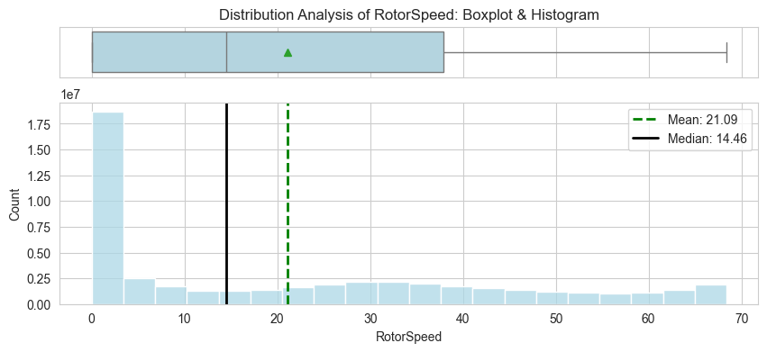
Distribution Analysis of Rotor Speed: Boxplot and Histogram

Slide 15
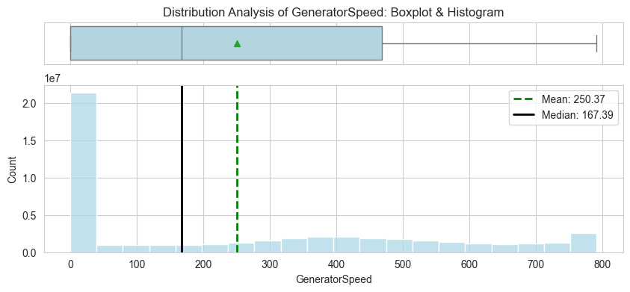
Distribution Analysis of Generator Speed: Boxplot and Histogram

Slide 16
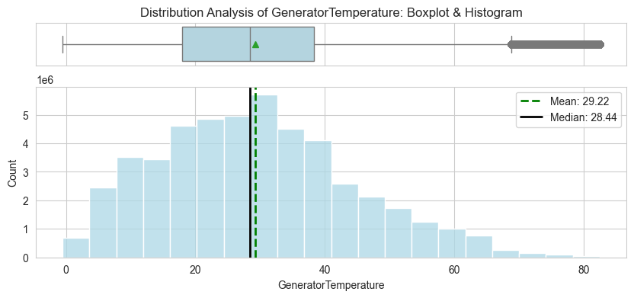
Distribution Analysis of Generator Temperature: Boxplot and Histogram

Slide 17
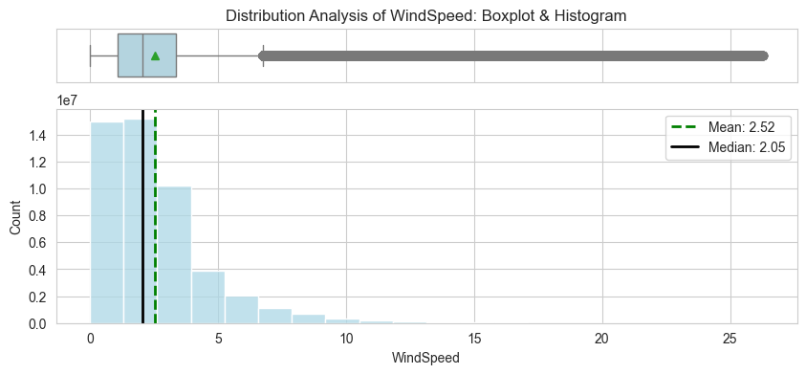
Distribution Analysis of Wind Speed:
Boxplot and Histogram

Slide 18
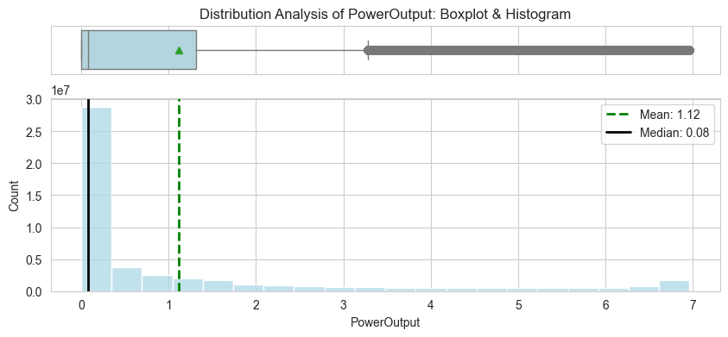
Distribution Analysis of Power Output:
Boxplot and Histogram

Slide 19
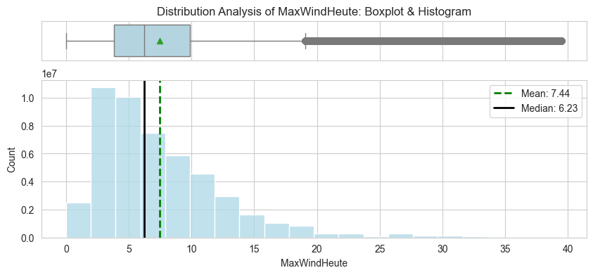
Distribution Analysis of Max Wind Heute:
Boxplot and Histogram

Slide 20
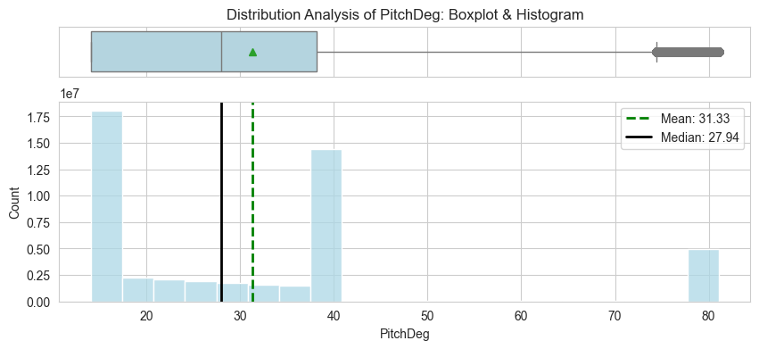
Distribution Analysis of Pitch Degree:
Boxplot and Histogram

Slide 21
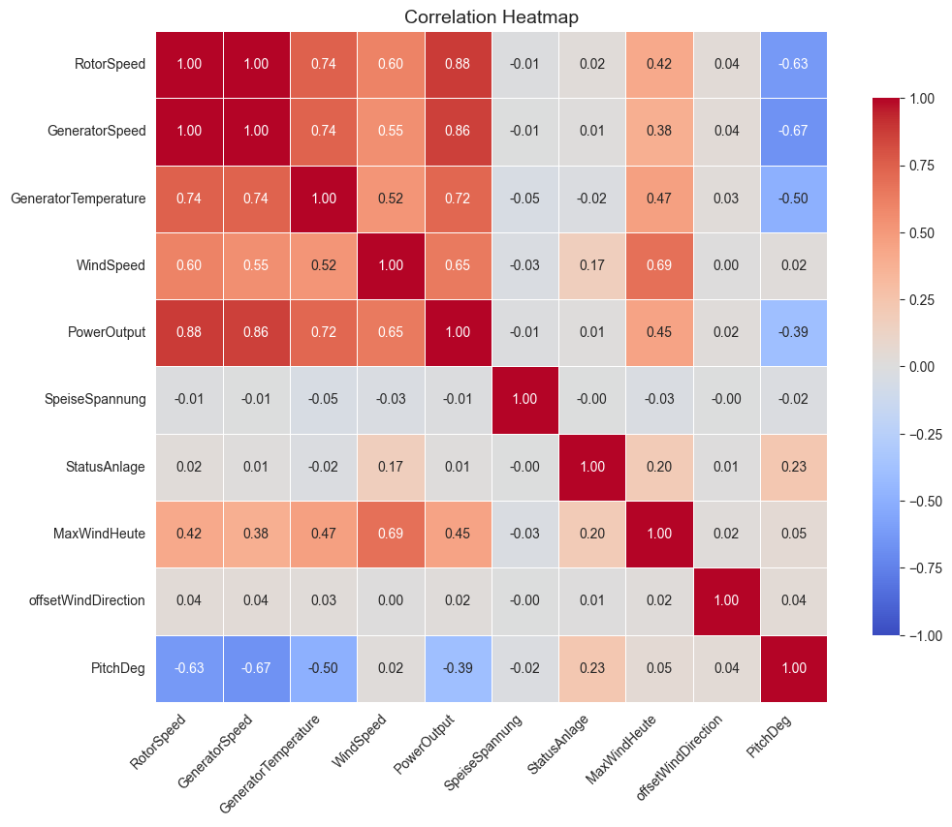
Correlation Heatmap

Slide 22
Modeling with Isolation Forest
Final model: Isolation Forest (unsupervised anomaly detection)
Used key sensor features: RotorSpeed, GeneratorTemperature, WindSeed, PowerOutput, etc
Applied StandardScaler to normalize inputs
Contamination set to 1% to flag rare anomalies
Model outputs:
Anomaly score per record
Anomaly labels: -1 (anomaly), 1 (normal)
~489k anomalies detected from ~49M records (~1%)
Threshold of 0.04 used to flag anomalies
Isolation Forest fit and prediction completed in ~3 minutes

Slide 23
Model Evaluation Without Labels
Anomaly score distribution
Time-series visual overlays of anomalies
Zoomed views of detected anomalies
Comparison of summary stats between anomaly and normal groups
This method allows anomaly detection even when true labels are unavailable - a common challenge in real-world industrial datasets

Slide 24
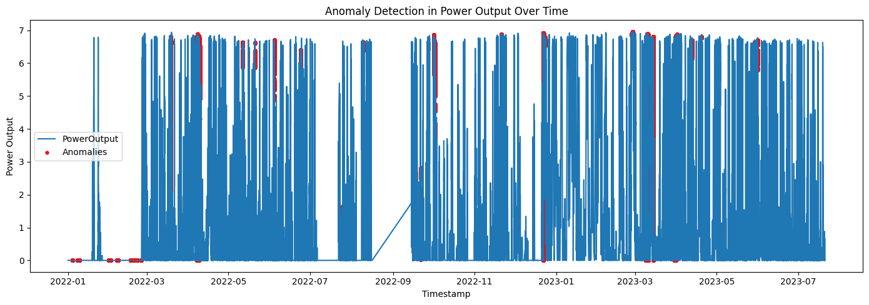
Anomaly Detection Plots
Red points indicate timestamps where Isolation Forest flagged unusual behavior in power output.

Slide 25
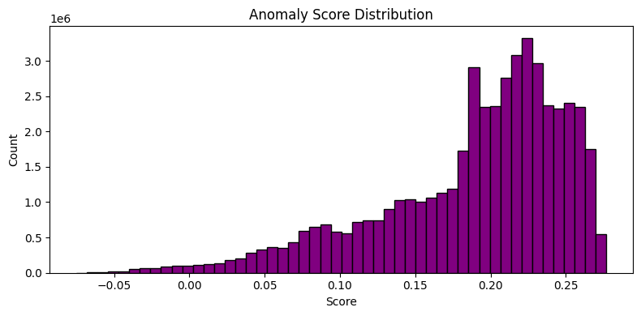
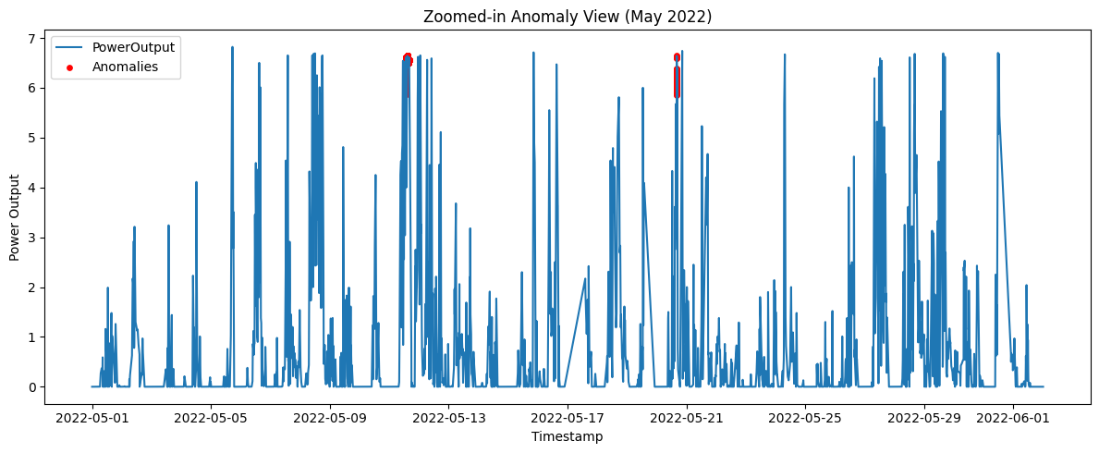
Anomaly Detection Plots
Most scores are clustered toward higher values, and outliers are isolated near the left tail. We used a threshold of ~0.04 to flag anomalies.
Zoom-in confirms that anomalies coincide with sudden, short-lived spikes — validating the model’s effectiveness visually.

Slide 26
Challenges and
Lessons Learned

Slide 27
Challenges
Data Size: Managing a 3 GB dataset with 40 million records required robust computational resources.
Undecoded Status Codes: Lack of decoding `StatusAnlage` column impeded detailed analysis
Team Collaboration: Working international posed coordination challenges
Time Management: Balancing the project with other courses required careful scheduling.
Notes:
One of the major challenges was handling the large dataset. At 3 GB and 40 million records, it necessitated significant computational resources. This required leveraging efficient data processing techniques and ensuring our systems could handle such a load to maintain performance.
The StatusAnlage column presented complications due to our inability to decode turbine status codes. This lack of clarity affected our ability to derive specific insights from the data, emphasizing the challenge of working with incomplete or undocumented datasets.
Collaborating internationally brought about difficulties requiring additional effort to ensure that all team members were on the same page and that communication was both frequent and clear.
Balancing this project with other coursework was challenging. It called for meticulous scheduling and prioritization to ensure that we met all of our academic and project deadlines.

Slide 28
Lessons Learned
Resource Planning: Essential for handling extensive datasets effectively
Data Understanding: Critical to address data preparation challenges early in the process
Effective Communication: Key to overcoming international collaboration hurdles
Prioritization: Necessary for achieving project goals alongside academic responsibilities
Notes:
Through this experience, we learned the importance of proactive resource planning. Ensuring that we had the right tools and systems in place was critical to processing our large datasets efficiently.
This project highlighted the necessity of addressing data preparation early on. Understanding full data context is crucial for effective analysis, and decoding issues like those with the StatusAnlage column must be planned for in the project timeline.
Working across international boundaries underscored the significance of clear and consistent communication. Using collaborative tools and establishing regular check-ins helped us navigate the complexities of remote teamwork.
Lastly, we appreciated the need for strong prioritization skills. Managing different obligations required clear goal-setting and time allocation, ensuring that both academic and project objectives were met successfully.

Slide 29
Conclusion
Successfully implemented an unsupervised anomaly detection system on large-scale turbine sensor data
Visual validation and statistical comparison confirmed the model’s ability to isolate abnormal behavior
This system supports proactive maintenance strategies to enhance turbine performance and reduce downtime
Future work could involve decoding status codes or obtaining labeled failure events for supervised learning

Slide 30
Q&A

